Slide 1
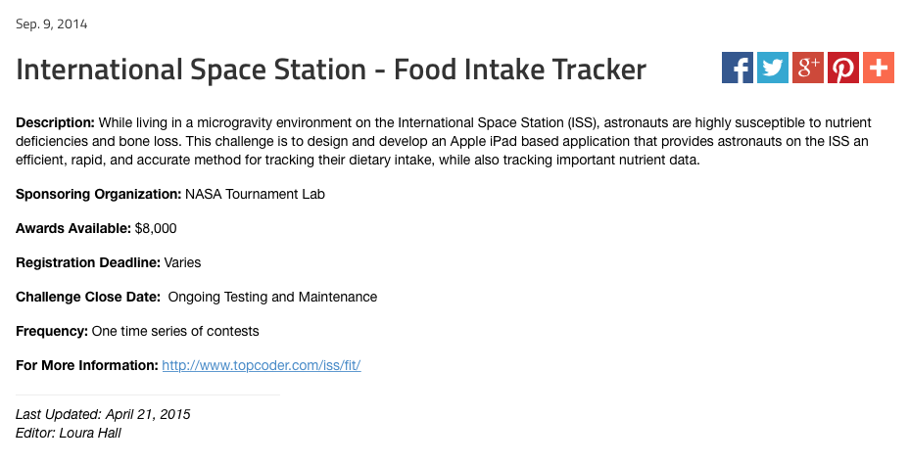
The Challenge
^{© TopCoder, Inc. 2013}
http://www.nasa.gov/content/international-space-station-food-intake-tracker

